Slide 1
ECE 313: PROBABILITY WITH ENGINEERING APPLICATIONS
Fall 2023
Prof. Eric Chitambar
Lecture 9

Slide 2



Geometric Distribution

Slide 3


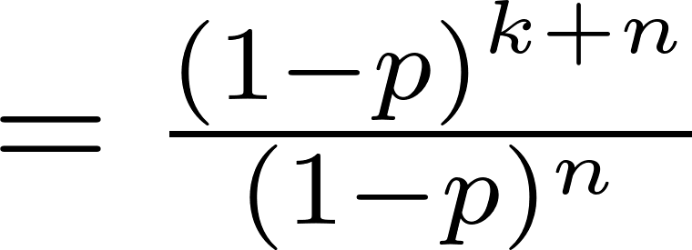


Geometric Distribution

Slide 4
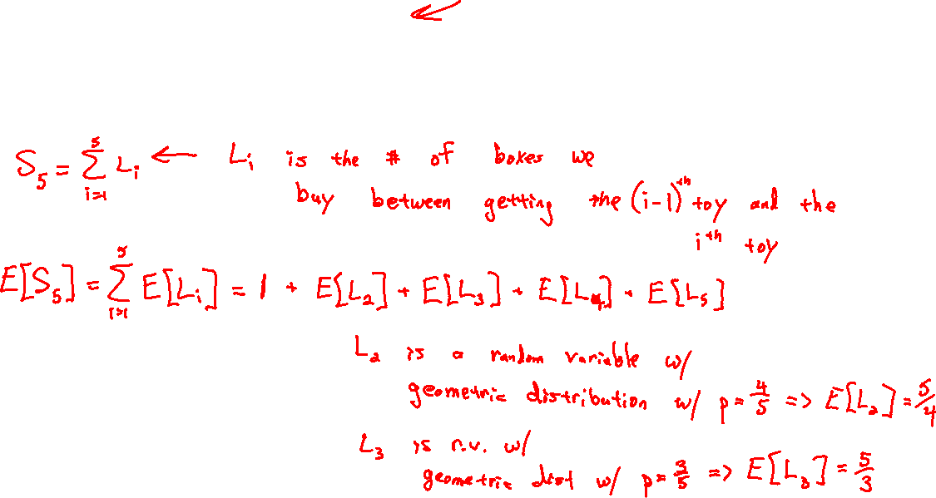
Geometric distribution

Slide 5
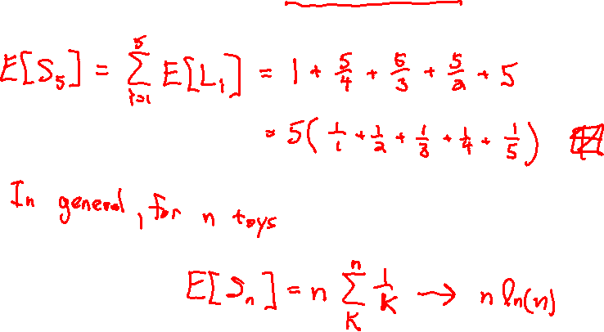
Geometric distribution

Slide 6


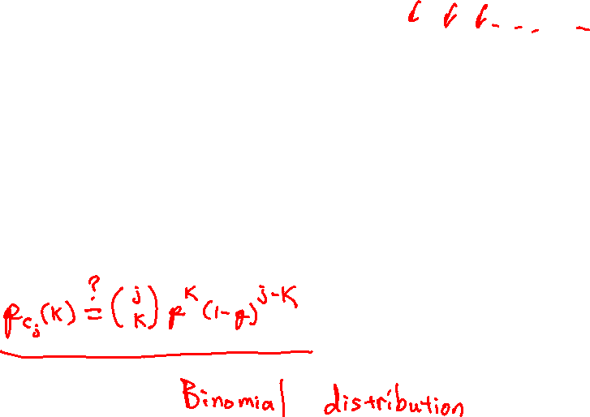
Bernoulli Processes

Slide 7

Bernoulli Processes

Slide 8
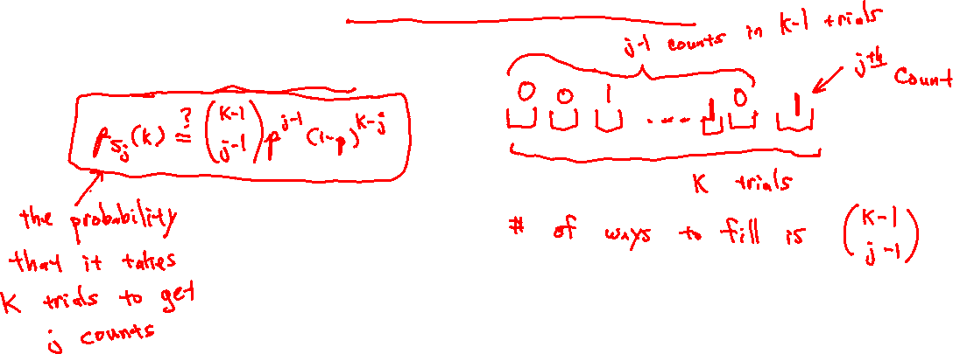
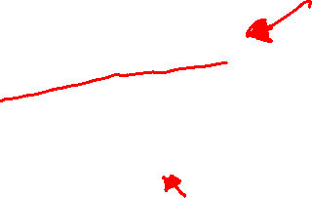
Bernoulli Processes

Slide 9

Bernoulli Processes

Slide 10
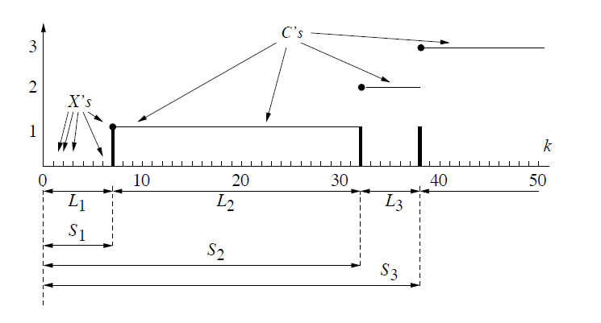

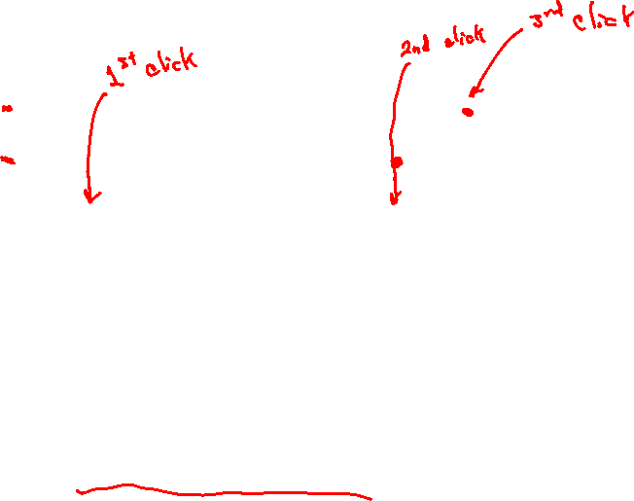
Bernoulli Processes

Slide 11



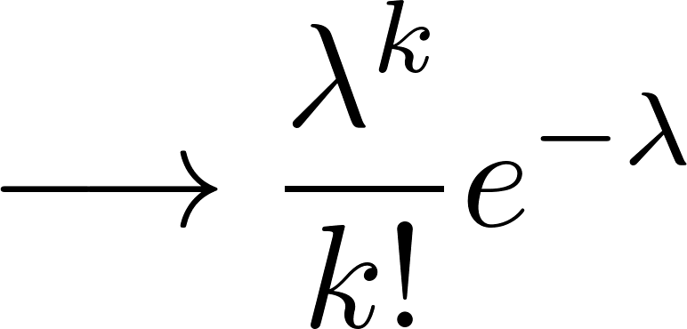
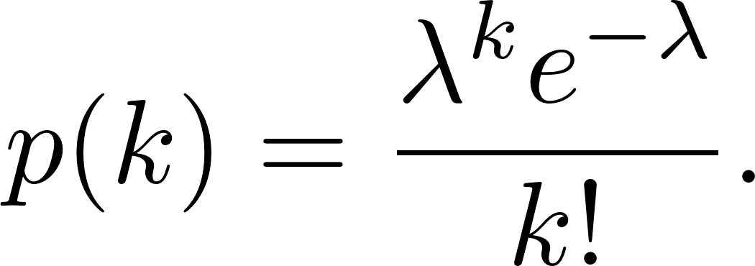
Poisson Distribution

Slide 12




Poisson Distribution

